Slide 1
Supervised Learning and Linear Regression
Instructor: Mohammad Hasan
Office: 13-240
08/26/26
Notes:
Welcome and Introductions

Slide 2
Overview
Review of types of machine learning
Hypotheses and Generalization
Linear Regression (single variable)
Linear Regression Generalization

Slide 3
Machine Learning Types
Machine Learning
Supervised Learning
Unsupervised Learning
Reinforcement Learning
Regression
Classification
Predict a number from a continuous space (example: temperature of a room)
Predict a category or a number from a discrete set

Slide 4
Supervised Learning Goal
Generalize knowledge based on provided examples to predict and generalize
Training Data
Full data X
Full data Y
Testing Data

Slide 5










Hypotheses and Generalization

Slide 6
Machine Learning Types
Machine Learning
Supervised Learning
Unsupervised Learning
Reinforcement Learning
Linear Regression
Neural Networks
And many other algorithms

Slide 7







Linear Regression Models (Single Variable)

Slide 8




Single Variable Linear Regression (Closed Form Solution)

Slide 9
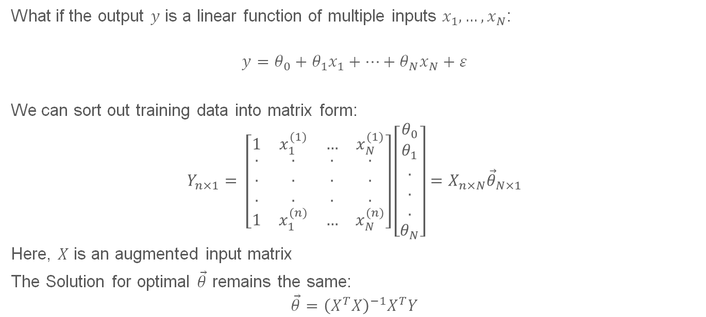
Generalization of Linear Regression (Multivariate linear regression)
What if the output $y$ is a linear function of multiple inputs $x_{1},…, x_{N}$:
$$y=θ_{0}+θ_{1}x_{1}+…+θ_{N}x_{N}+ε$$
We can sort out training data into matrix form:
$$Y_{n×1}= \left[\begin{matrix}1 & x_{1}^{(1)} & … & x_{N}^{(1)} \\ \begin{aligned}. \\ . \\ .\end{aligned} & \begin{aligned}. \\ . \\ .\end{aligned} & \begin{aligned}. \\ . \\ .\end{aligned} & \begin{aligned}. \\ . \\ .\end{aligned} \\ 1 & x_{1}^{(n)} & … & x_{N}^{(n)}\end{matrix}\right]\left[\begin{matrix}θ_{0} \\ \begin{aligned}θ_{1} \\ . \\ . \\ . \\ θ_{N}\end{aligned}\end{matrix}\right]=X_{n×N}{\vec{θ}}_{N×1}$$
Here, $X$ is an augmented input matrix
The Solution for optimal $\vec{θ}$ remains the same:
$$\vec{θ}={\left(X^{T}X\right)}^{−1}X^{T}Y$$

Slide 10
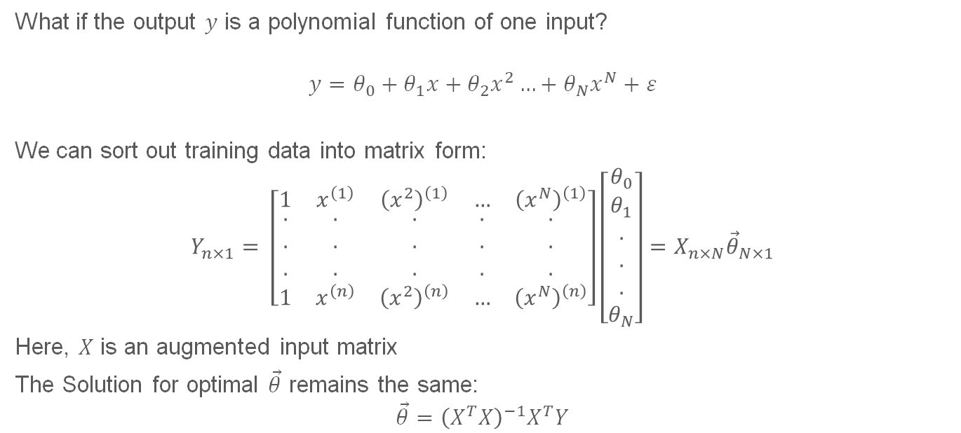
Generalization of Linear Regression (Polynomial regression)
What if the output $y$ is a polynomial function of one input?
$$y=θ_{0}+θ_{1}x+θ_{2}x^{2}…+θ_{N}x^{N}+ε$$
We can sort out training data into matrix form:
$$Y_{n×1}= \left[\begin{matrix}1 & x^{\left(1\right)} & {\left(x^{2}\right)}^{\left(1\right)} & … & {\left(x^{N}\right)}^{\left(1\right)} \\ \begin{aligned}. \\ . \\ .\end{aligned} & \begin{aligned}. \\ . \\ .\end{aligned} & \begin{aligned}. \\ . \\ .\end{aligned} & \begin{aligned}. \\ . \\ .\end{aligned} & \begin{aligned}. \\ . \\ .\end{aligned} \\ 1 & x^{\left(n\right)} & {\left(x^{2}\right)}^{\left(n\right)} & … & {\left(x^{N}\right)}^{\left(n\right)}\end{matrix}\right]\left[\begin{matrix}θ_{0} \\ \begin{aligned}θ_{1} \\ . \\ . \\ . \\ θ_{N}\end{aligned}\end{matrix}\right]=X_{n×N}{\vec{θ}}_{N×1}$$
Here, $X$ is an augmented input matrix
The Solution for optimal $\vec{θ}$ remains the same:
$$\vec{θ}={\left(X^{T}X\right)}^{−1}X^{T}Y$$

